Slide 1
Lecture 17
First Order Logic
Yaohang Li
Department of Computer Science
ODU
Reading for This Class:
Chapter 7, 8, 9, Russell and Norvig

Slide 2
Review
Last Class
Inference
Unit Resolution Rule
Full Resolution Rule
Propositional Logic Inference using Resolution Rule
This Class
First Order Logic
Next Class
Fuzzy Logic

Slide 3
Pros and Cons in Propositional Logic
Propositional Logic is declarative
Propositional Logic is compositional
Meaning of B∧P is derived from meaning of B and of P
Meaning in Propositional Logic is context-independent
Unlike natural language, where meaning depends on context
Propositional Logic has very limited expressive power
Unlike natural language
Cannot express the following sentence
All students pass the midterm
Everyone who passed age 21 can drink
One student in this class got perfect score

Slide 4
First-Order Logic
Rather Powerful Representation and Reasoning System
Very well understood and extensively studied (a couple of thousand years!)
Many Fancy Knowledge representation formalisms

Slide 5
Ontological Commitments
Objects
The world is made of objects
Things
Identities and Properties distinguish them
Nouns and noun phrases
Relations
Various relations hold among objects
Some of the relations are functional (Functions)
Verbs and verb phrases
Fact
Every fact involving objects and their relations is either true or false

Slide 6
The Language of First Order Logic
Symbols
Variables
Constant Symbols
Functional Symbols
Relational Symbols
Logical Symbols
Connectives
¬, ∧, ∨, ⇔, ⇒
Quantifier
∀ (for all), ∃ (there exists)
Equality
= (equal)

Slide 7
The language of First Order Logic
Terms
A variable is a term
A constant symbol is a term
If f is an n-ary function symbol and t1,…, tn are n terms, then f(t1, …, tn) is a term
Nothing else is a term
Sentences
True (False) is a sentence
If t1, t2 are terms, t1=t2 is a sentence
If p is an n-ary relation symbol and t1, …, tn are n terms, p(t1, …, tn) is a sentence
If ϕ is a sentence, ¬ ϕ, ∀xϕ, ∃xϕ are sentences
If ϕ1, ϕ2 are sentences, ϕ1⇔ ϕ2, ϕ1⇒ ϕ2, ϕ1∧ ϕ2, ϕ1∨ ϕ2 are sentences
Nothing else is a sentence

Slide 8
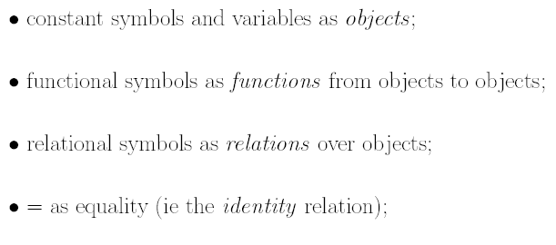
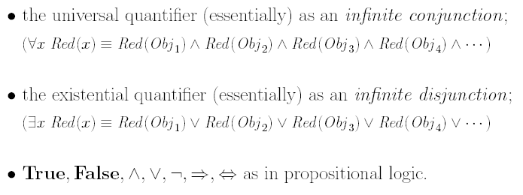
Semantics of First-Order Logic
Interprets

Slide 9
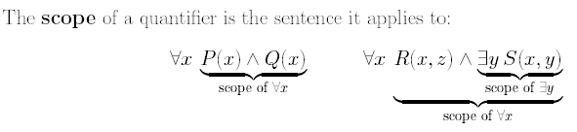
Scope of Quantifiers

Slide 10
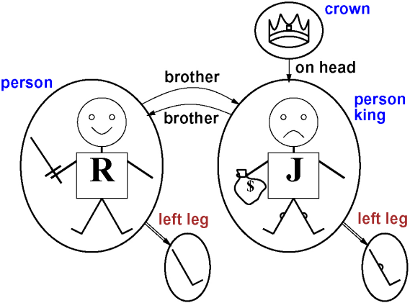
Models for FOL
Models for PL are just set of truth values for the propositional symbols.
Models for FOL contain a set of objects (domain elements) and relations among them.
Richard the Lionheart
evil King John
A model containing 5 objects, 2 binary relations, 3 unary relations, and 1 unary function (left leg)

Slide 11
Quantifiers – Universal quantification
“For all …”
says that P is true for every object x.
e.g.
Precisely, is true in a given model under a given interpretation if P is true in all possible extended interpretations, each specifying a domain element to which x refers.
e.g.
{Richard the Lionheart, King John, Richard’s left leg, John’s left leg, the crown}
conjunction of instantiations of P
True? | False?
The implication is true whenever its premise is false – regardless the truth of the conclusion.
Asserting the conclusion of the rule just for those objects for whom the premise is true and saying nothing at all about those individuals for whom the premise is false.

Slide 12
A common mistake to avoid
implication
is the natural connective with
Common mistake:
Using conjunction
with
leads to a overly strong statement!
e.g.
Everybody at ODU is smart.
Everybody is at ODU and everybody is smart.
e.g.
The crown is a king and the crown is a person

Slide 13
Quantifiers – Existential quantification
says that P is true for at least one object x.
“There exists an x such that …” or “For some x …”
e.g.
Precisely, is true in a given model under a given interpretation if P is true in at least one extended interpretation that assigns x to a domain element.
disjunction of instantiations of P
e.g.
(Richard’ left leg is a crown
Richard’ left leg is on John’s head)
(The crown is a crown
The crown is on John’s head)

Slide 14
A common mistake to avoid
conjunction
is the natural connective with
Common mistake:
Using implication
with
leads to a very weak statement!
e.g.
Somebody at ODU is smart.
is true if there is anybody who is NOT at ODU
is true if there is anybody who is smart
e.g.
If Richard’s left leg is a crown then Richard’s left leg is on John’s head.

Slide 15
Connections between ∃ and ∀
Quantifier duality: each can be represented using the other
is really a conjunction over the universe of objects and is a disjunction
P 252 De Morgan rules

Slide 16
Using FOL – The kinship domain
Kinship: family relationship
Facts
Rules
e.g.
Mary is the mother of Charles
Charles is the father of William
e.g.
One’s grandmother is the mother of one’s parent
Using First-order Logic:
Objects are people
Unary predicates: Male and Female
Kinship relations represented by Binary predicates: Parent, Sibling, Brother, Husband, Grandparent, etc.
Functions: Mother and Father

Slide 17
Predicates for the Kinship Domain
Male, Female
Parent, Sibling, Brother, Sister, Child, Daughter, Son, Spouse, Wife, Husband, Grandparent, Grandchild, Cousin, Aunt, Uncle.
Spouse(Bill, Hilary), Husband(Bill, Hilary), Husband(Hilary, Bill)
Functions for the Kinship Domain
Mother, Father
Father(Chelsea), Mother(Chelsea)

Slide 18
In Class Exercise: FOL Expressions
One’s mother is one’s female parent
One’s husband is one’s male spouse
Male and Female are disjoint categories
Parent and child are inverse relations
A grandparent is parent of one’s parent
A sibling is another child of one’s parent
One can have only one mother

Slide 19
In Class Exercise: FOL Expressions
One’s mother is one’s female parent
∀m,c Mother(m, c) ⇒Female(m) ∧Parent(m,c)
One’s husband is one’s male spouse
∀w,h Husband(w)=h ⇒Male(h) ∧Spouse(h,w)
Male and Female are disjoint categories
∀x Male(x)⇔¬Female(x)
Parent and child are inverse relations
∀p,c Parent(p,c)⇔Child(c,p)
A grandparent is parent of one’s parent
∀g,c Grandparent(g,c) ⇒ ∃p Parent(g,p)∧Parent(p,c)
A sibling is another child of one’s parent
∀x,y Sibling(x,y) ⇒ ¬x=y ∧ ∃p Parent(p,x)∧Parent(p,y)
One can have only one mother
∀c ∃m Mother(m,c) ∧ ∀x x≠m ⇒ ¬Mother(x,c)

Slide 20
Summary
First Order Logic
Language
Components
Terms
Sentence
Expressions in First Order Logic

Slide 21
What I want you to do
Review Chapter 7, 8, 9
Work on your assignment
Work on your term project
Prepare for your midterm

